Slide 1
REAL-TIME SEED IDENTIFICATION
Group 11 - Green Team
OMAR ELGEBALY
XIAOYI YANG
VINAYAKA THOMPSON

Slide 2
Project Overview - Purpose
a need to sort seed.
grading for pricing purposes
cleaning for reseeding.
Done by hand
Hard when seeds are small
Usually, 90% of job removing good seed

Slide 3
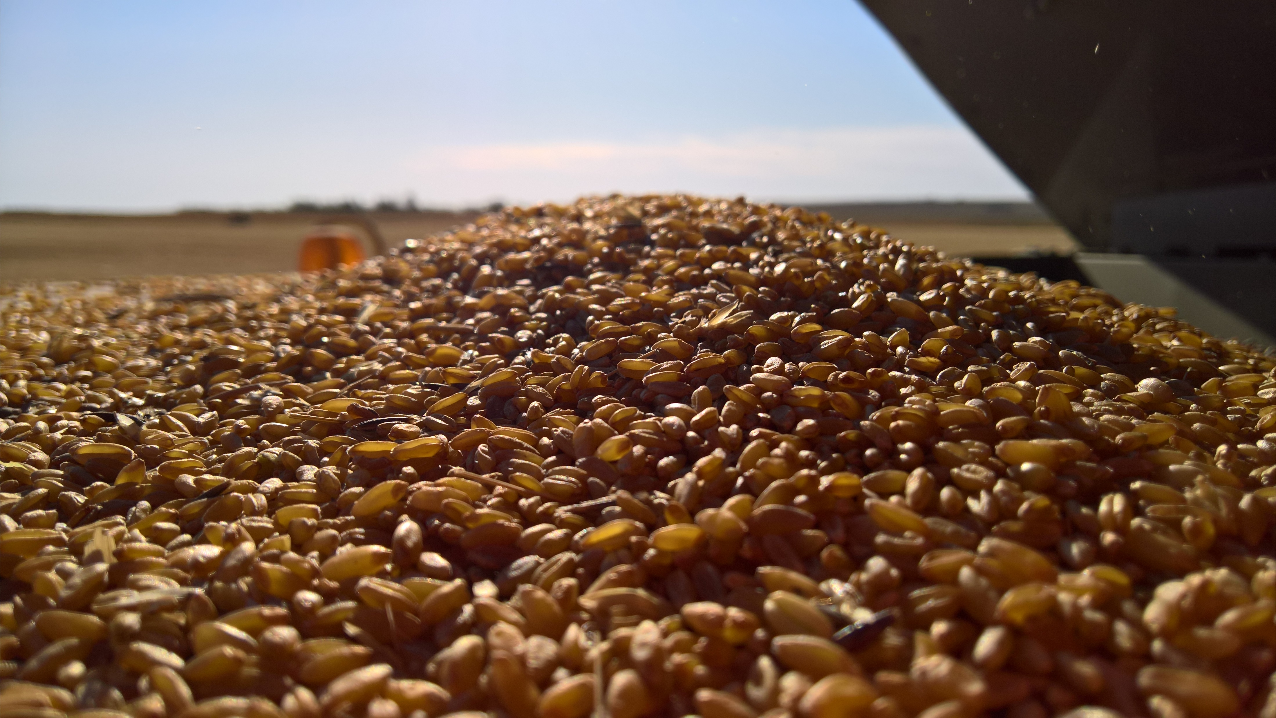
Project Overview - Client
Primarily for the seed lab
There is, however, a secondary group that this device could be targeted to namely farmers needing to clean small

Slide 4
Project Overview - Scope
The product to be created by our team is a program that is to work with a theoretical set of hardware components to
sort seed. We must design our software with our hardware constraints in mind.
This program is designed to take a photo of the seed (in this case Tall Fescue), process it locally, and then send a signal only if an off-type is detected.
The algorithm we make should be able to accurately identify alien seed within a maximum 20% margin of error.
When testing seed, the fully assembled device should be able to process about 14 seeds per second or a batch of
25,000 seeds in 30 minutes.

Slide 5
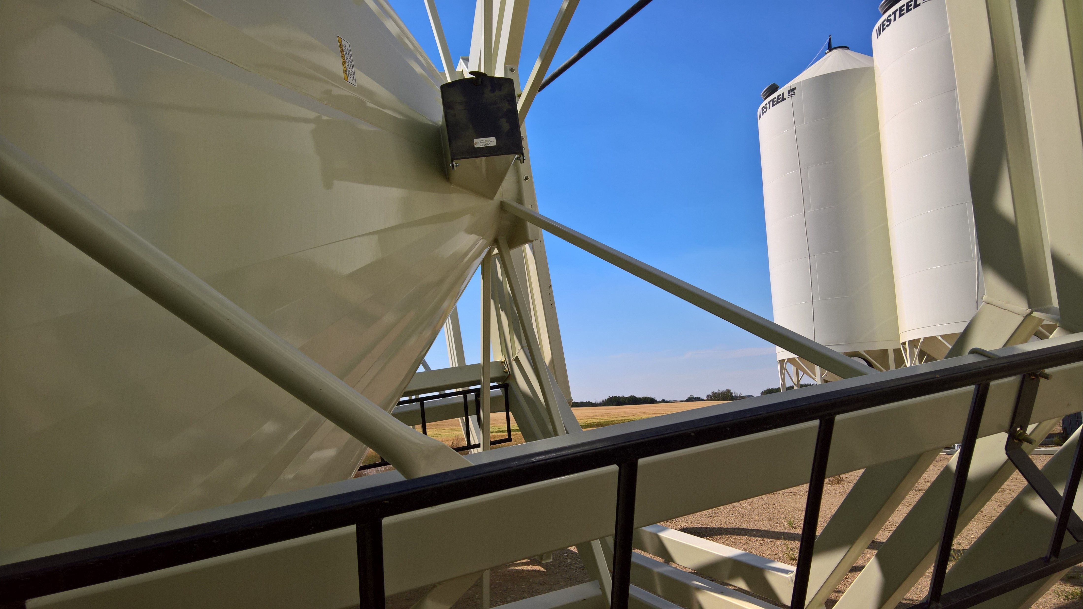
Project Overview – Extension Projects
2 projects
Let client train device for new types of seeds
Switch type through a user interface
Also categorizing new Off type seeds

Slide 6
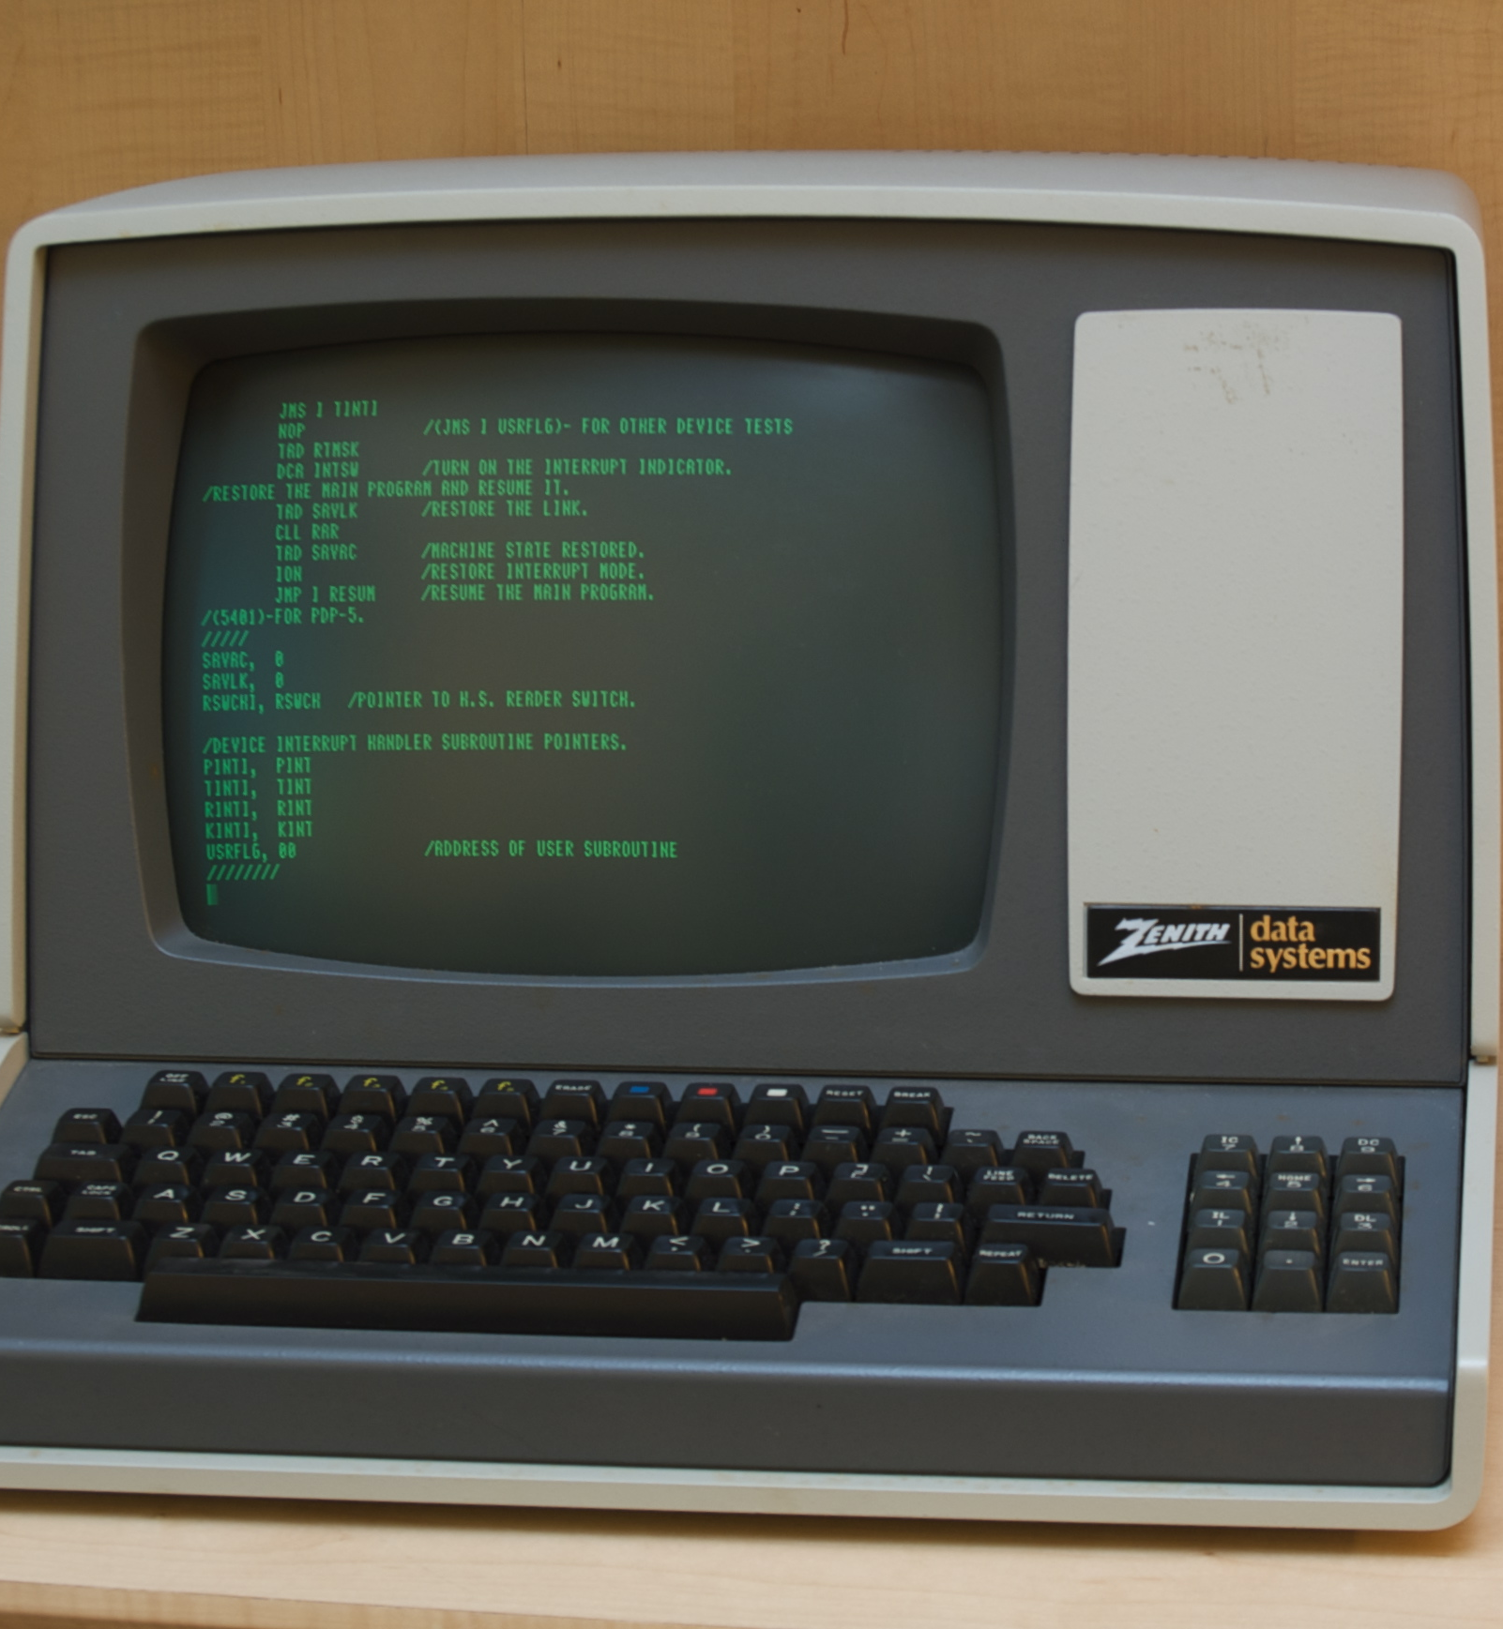
Data Collection
Camera Serial Bus vs Universal Serial Bus
Nvidia Jetpack
Use TensorRT / Vision Works
Speed things up
cuDNN
CUDA
https://developer.nvidia.com/embedded/jetpack
Pic credit https://upload.wikimedia.org/wikipedia/commons/1/19/Zenith_Z-19_Terminal.jpg

Slide 7
Data Preprocessing
Will need to perform image transformations to enhance readability by the model
Will need to modify scale and format. Tensorflow prefers image in RTF format

Slide 8
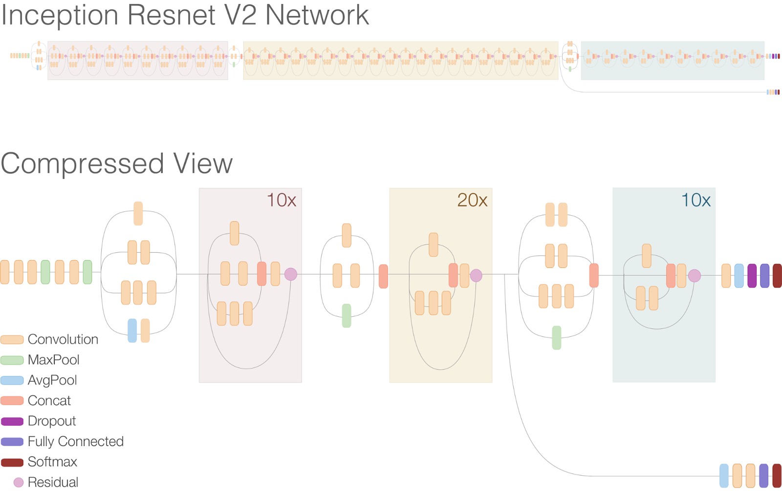
Data Training
Will utilize Inception Resnet V2 Network
https://research.googleblog.com/2016/08/improving-inception-and-image.html

Slide 9
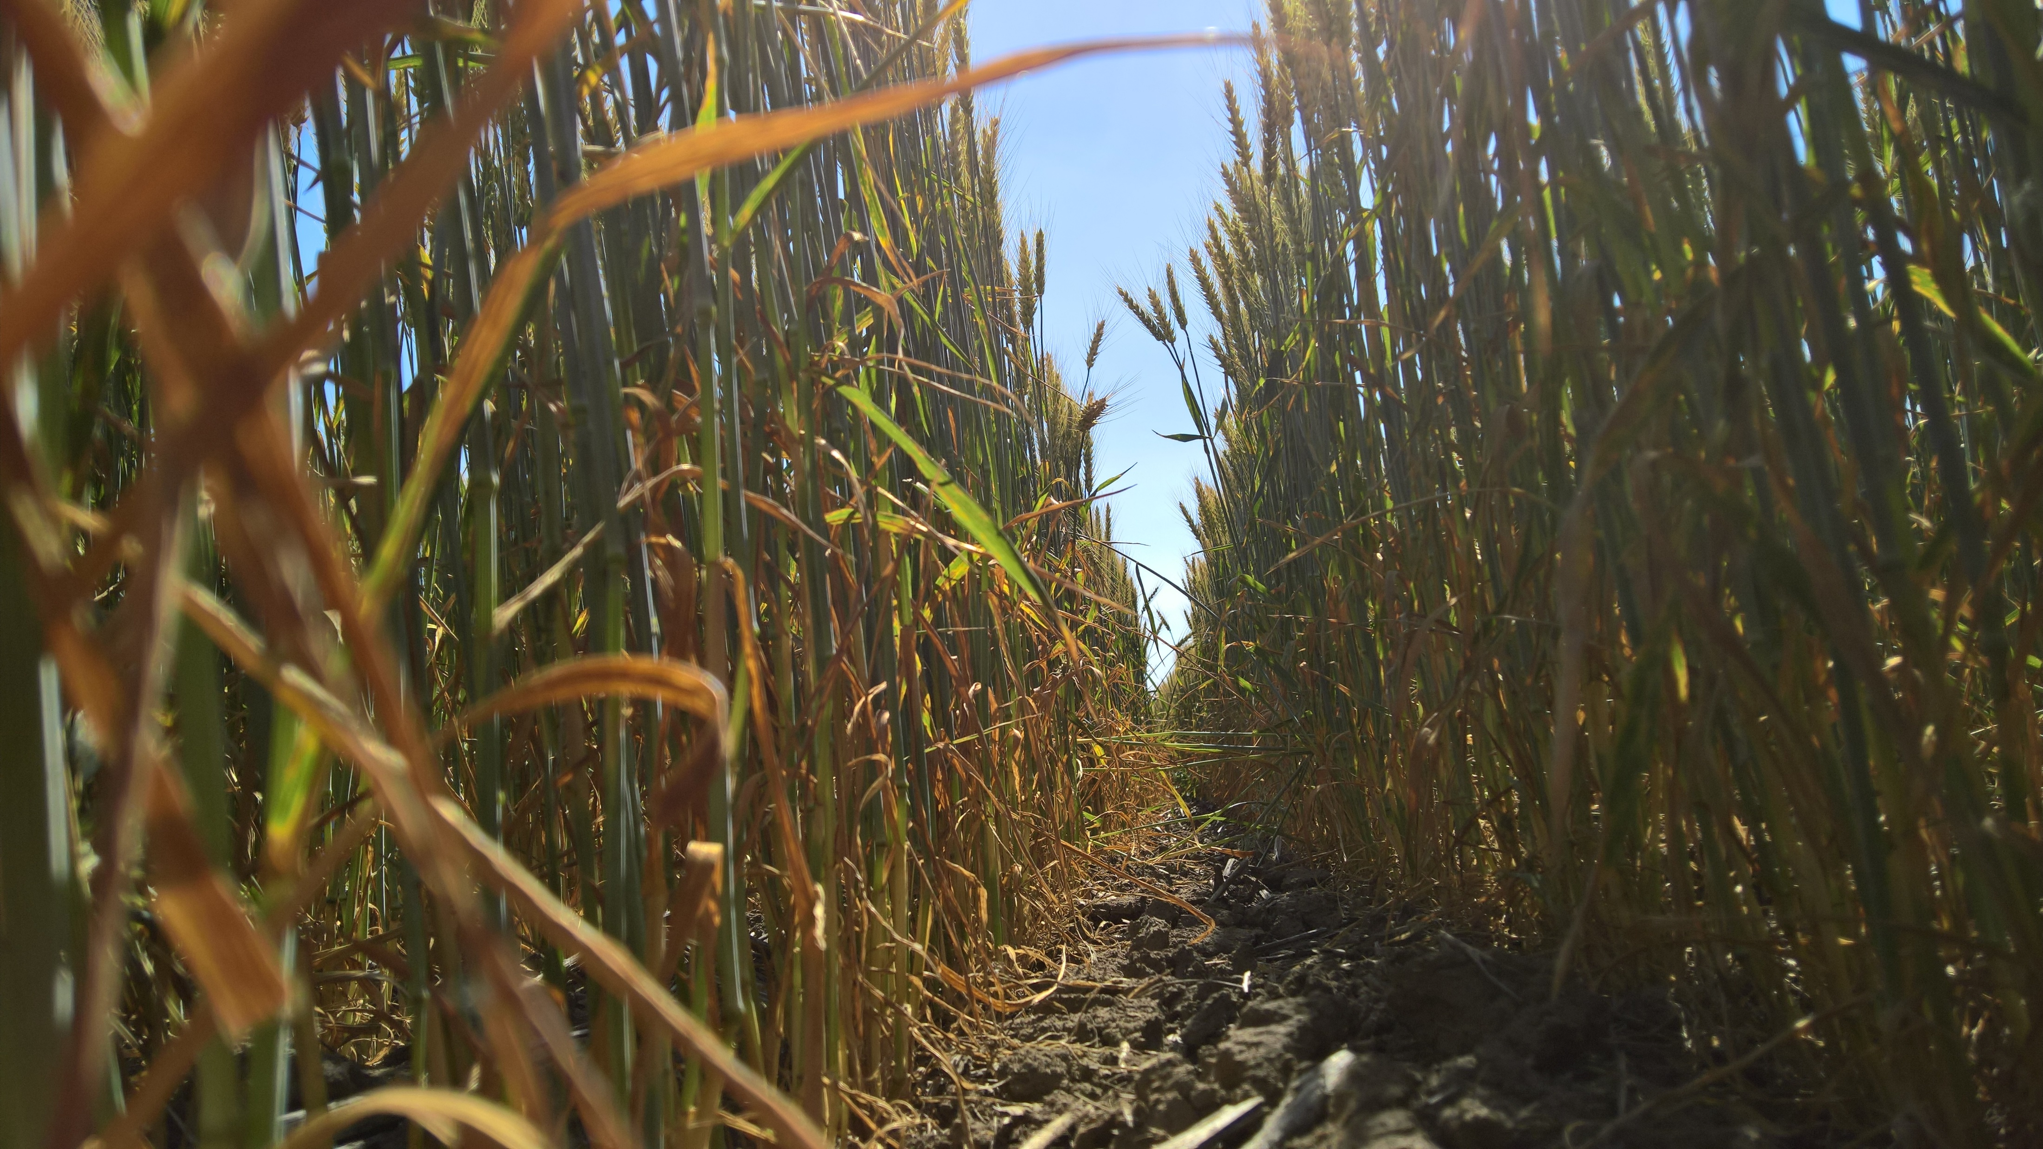
Data Testing
Early Model Test
Will determine if dataset has trained properly by testing a small set of images from the internet
Final Model Test
Final test we perform by testing untrained Tall Fescue images in real time against the entire trained dataset.

Slide 10
Problems - Personal
Communication
Schedules tough to do in person meetings
Only using email was a problem
Solution : Discord
Created a voice chat server

Slide 11
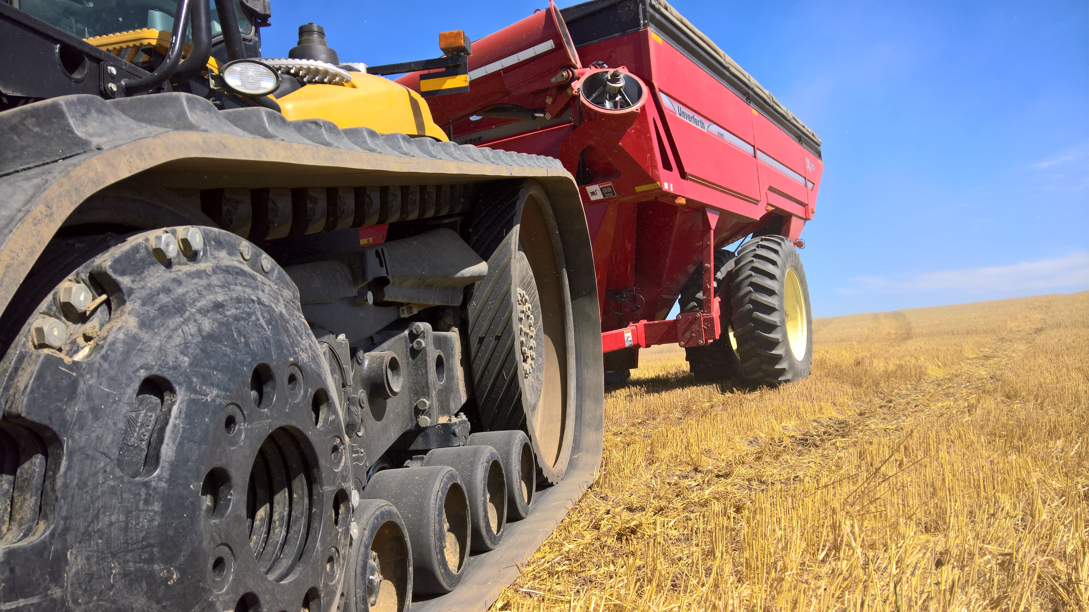
Problems - Technical
Finding info on how to time the this specific system
Over load of research
Primary Research indicated we train a large dataset
Better idea seems to be smaller data set with classifier
We want to integrate with mechanical team project which is causing problems

Slide 12
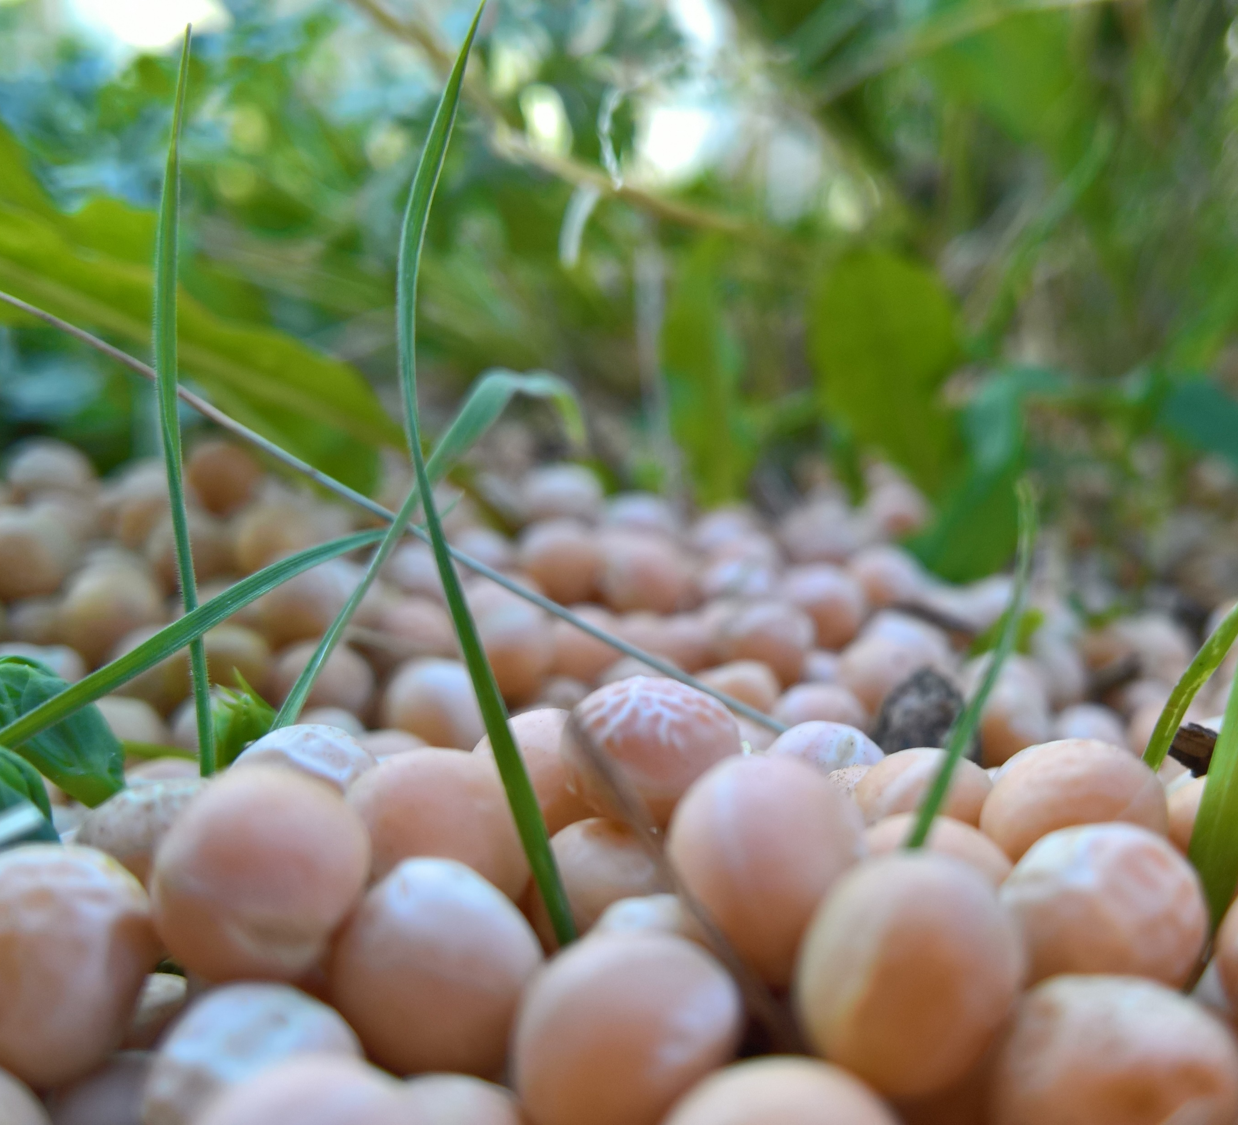
Retrospective
Beavers
We get how much work needs to be done now
Ducks
Need to be better at meeting deadlines
Need to improve communication
No shared file for us to work on
Actions
Created Discord
Share latex

Slide 13
Term at a glance
Week1
Met as a group
Week2
Met with client for first time
Week3
Problem statement
Week4
Not much was done
Week5
Requirements rough draft
Week6
Completed Requirements
Week7
Tech Review work
Week8
Talked to mechanical group
Week9
Determined roles for the project
Week10
Progress report and design doc

